Slide 1

Python

Slide 2
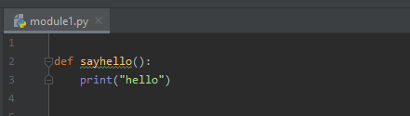
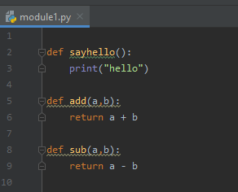
Modules
In our previous lessons, we learned how to import modules but we haven’t really explain what is modules.
So basically Modules are a group of codes or data, it may be variables, functions, or classes. we group them so that we can easily reuse them in the future.
To create a module we just have to create a separate file with the module name that we desired.
In this example, we created a module named “module1”.
We can add other functionalities to the module.

Slide 3
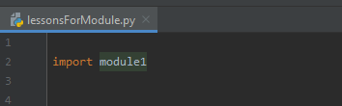
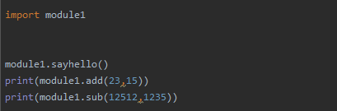

Modules
To call our module we simply have to import it as any other module available.
As you can see in here, we created another file and imported the module that we made.
After we import the module, we can now use all the functions that we made.

Slide 4
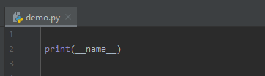



Special Variable __name__
Most of the time when we are building a project, we will be using modules and there would be a difference on what will the __name__ returns.
To explain how we will be using the special variable, lets create a module named “demo.py”
In the demo.py when we print the special variable it gave us __main__ because that is the point of execution, it is where our code starts.
Now lets create another module named “proj1.py” and in this module we will import demo.py
Since we imported proj1.py, it will run the print statement from the demo.py and the value will be the module name.

Slide 5
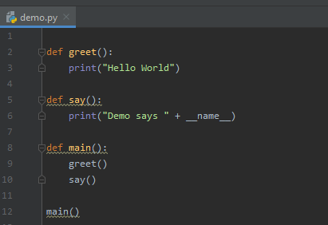

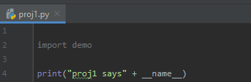

Special Variable __name__
So how do we usually use this __name__?
Most of the time in a module, there are processes that will be run automatically. Lets say in demo.py we have a function that will be run from the start of execution.
Now the problem is if we run the proj1.py it will also run all method of demo.py since we imported the module.

Slide 6
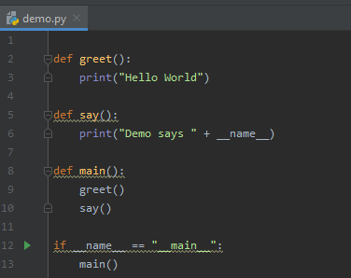

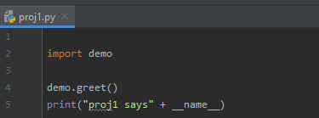

Special Variable __name__
So to avoid running automatically in other modules, in demo.py we will be running functions automatically only if we are in the demo.py
Now in the proj1.py, it will only run those methods that we will call manually.

Slide 7
Introduction to OOP
One of the reason why Python is famous is because it supports all different programming paradigm, it supports functional programming, OOP, and it also works with procedure oriented programming.
OOP stands for Object Oriented Programming, since everything in Python is an object, we should learn how OOP works.
In OOP, we have so many concepts, some of these are objects, classes, encapsulation, abstraction, and polymorphism.
What is object and why is it important?
Object are usually modeled in real-world objects you find in everyday life. This may be persons, phones, chairs, houses, vehicles, etc.
In an object, there are 2 things to take note, every object will have certain attributes and certain behaviors.
Attributes are like data or properties of an object while behaviors are the actions that can be perform by the object. We will define attributes to variables while to be able to have behaviors, we will use methods.
Basically methods are just functions in OOP.
So since we will be learning first about object, we need to also know what is a class.
Class is the design or the blueprint of an object. It is where we will define its data and behaviors.

Slide 8

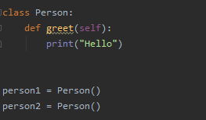
Classes and Objects
In this lesson we will be learning how class and object works.
If we want an object we need to create a class.
The way we define a class is using the class keyword and having a class name.
Inside the class where we will be creating its variables and methods.
In this example we have a simple method greet.
To define an object, we simply have to assign it to the class.

Slide 9
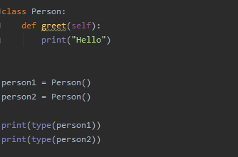

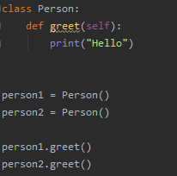

Classes and Objects
If we check the type of the object that we created we will see that it is an object of Person, or we also say that it is an instance of the class Person.
In the Person class, we created a method, for our object to access this method, we simply have to pass the object ot the method.

Slide 10
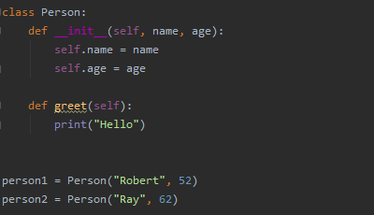
Init Method
When we talk about objects, object will have 2 things, attributes and methods. When we say attributes, these are just variables.
Since class is the blueprint of an object, we will be creating the attributes of an object inside a class using the Init Method.
Init method is a special method that will initialize variables. Init method will be called once automatically in every object that we will have.

Slide 11
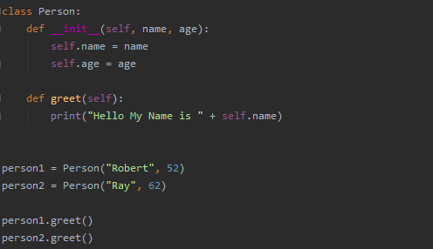

Init Method
To pass it to another method we also need to include self.

Slide 12

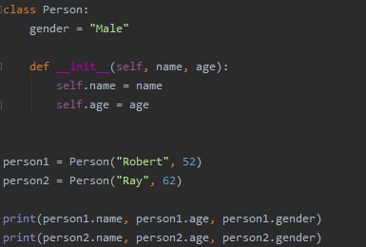

Types of Variable
There are two types of variable in OOP:
Instance variable
Class variable/ static variable
Instance variable is the variable inside the Init method. Instance variable can have different values per objects.
Class variable is a variable outside the Init method. It is a common variable for every object that we create.

Slide 13
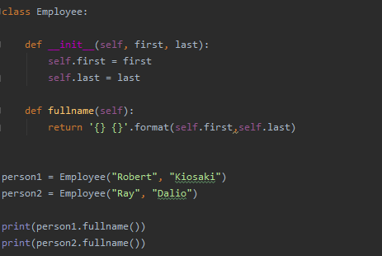

Types of Methods
There are 3 types of methods in OOP:
Instance method
Class method
Static method
Instance methods directly affects or interact with each object. Instance method take the instance (self) as the first argument automatically.

Slide 14
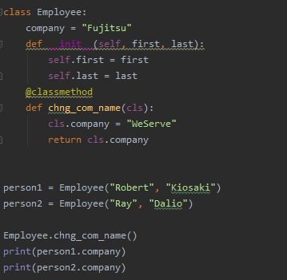

Types of Methods
Class methods are methods that affect all objects. We usually interact with a class variable using the class method.
Class methods takes the class as the first argument automatically.
To identify that it is a method we need a decorator @classmethod above the class method.
To call a class method, we need the class name and the method name.

Slide 15
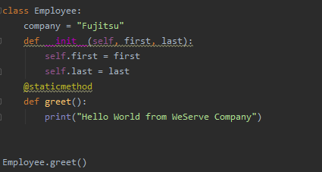

Types of Methods
Static methods are methods that has no direct interaction with the class or variables but has a logical connection to the class. Static methods will not have arguments automatically.
To define a static method, we need the decorator @staticmethod.

Slide 16
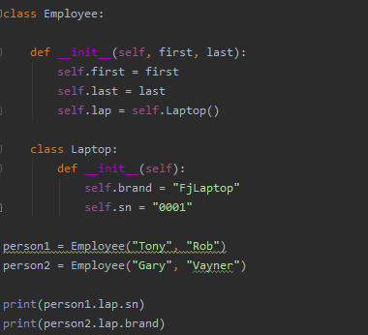

Inner Class
Python OOP has a concept of having a class inside a class. Normally we do this when we need an object that would be specifically use with a single class.
To define an inner class, it is actually the same with how we normally define an outer class. We also need to assign it with an instance variable in the outer class.

Slide 17
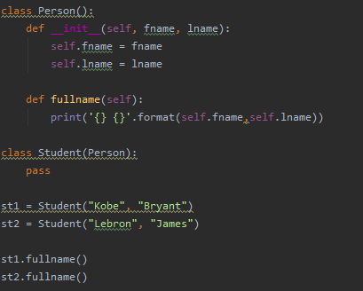

Inheritance
In OOP we use inheritance in classes if we want to use certain existing features that is in another class. This would save us time and energy from creating same features that already exist.
To inherit a class, we simply need to put the class that we will inherit inside a round bracket.
We have 3 types of inheritance:
Single level inheritance – it is when we have 2 classes, a super class and a sub class where a sub class inherits from super class.

Slide 18
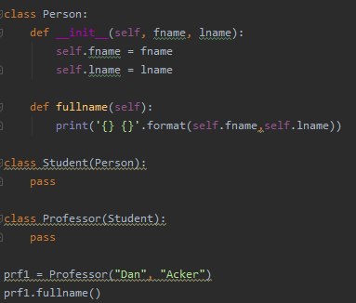

Inheritance
Multi level inheritance – it is when we have 3 or more classes, where a sub class inherits from another sub class.

Slide 19
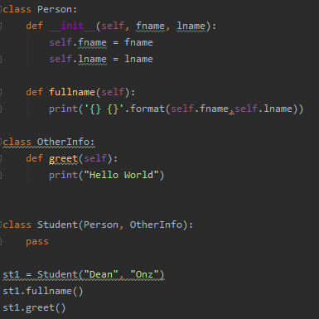

Inheritance
Multiple inheritance – it is when we have 3 or more classes, where a class inherits from multiple classes with different features. We can accomplish this by simply adding other class in the round bracket.

